Slide 1
Advocacy & Campaigning Policy
For all colleagues

Slide 2
Why we need an Advocacy & Campaigning Policy
This new Policy helps us to deliver our Strategy and our Theory of Change – where we have committed to changing Government policy and changing attitudes.
It will allow us to speak out with children and young people whilst making sure we stay within the law and regulation, and protect our reputation.
This policy applies to all colleagues, including volunteers, all year round but it’s especially important during the election campaign.

Slide 3
Our advocacy principles
Beyond our charitable objects (what the charity exists to achieve), we need to make sure our activities are based on:
Our Strategy and Theory of Change
All our activities should be within these ‘guardrails’
Evidence
Either internally from children and young people or from trusted external sources
Independence
We must be and appear to be independent of political parties, to remain in line with charity and election law.
Collaborative
Where appropriate we will work with others, recognising we can go further when we go together.

Slide 4
Our ways of working (1)
To make sure we follow our advocacy principles and to protect our reputation, the following activities will be closely managed:
Direct contact with national, regional and local politicians and other decision makers about policy
Public statements regarding policy positions
Commenting on or seeking to influence policy or the public
Any activity that can be perceived as intended to influence or campaign on public policy
All activity of this kind should be managed by the Policy and Public Affairs Team, or the External Communications and Engagement Team, as appropriate.
Approval will be based on an escalation process, agreed with the Board of Trustees.

Slide 5
Our ways of working (2)
Our policy development is guided by internal and external evidence – so it reflects the voices and experiences of children and young people.
Our policies are developed in consultation with relevant leadership across Children’s Services as well as others.
Wherever possible and appropriate, we involve children and young people directly in the development of policy positions.
No advocacy or campaigning content should be shared with decision makers or published in Barnardo’s name outside of these governance arrangements.
Where we work in partnership with others we will follow due diligence processes and we will remain vigilant about protecting our reputation.

Slide 6
What this means during the election campaign
Context
Charities are under greater scrutiny during the election period.
We need to be particularly careful that we a) adhere to law and policy and b) take additional steps to protect our reputation.
We will take additional care to ensure that in doing so we minimise the risk of being seen as aligned to any political party.
What we will do
Continue speaking out on issues that affect children, in line with our manifesto.
Respond to relevant policy announcements – including in partnership with other children’s charities.
Prepare to influence the next Government.
What we won’t do
We have decided that we will not engage in ‘regulated’ campaign activity – this means we must not do anything that could be seen as attempting to influence how people will vote.

Slide 7
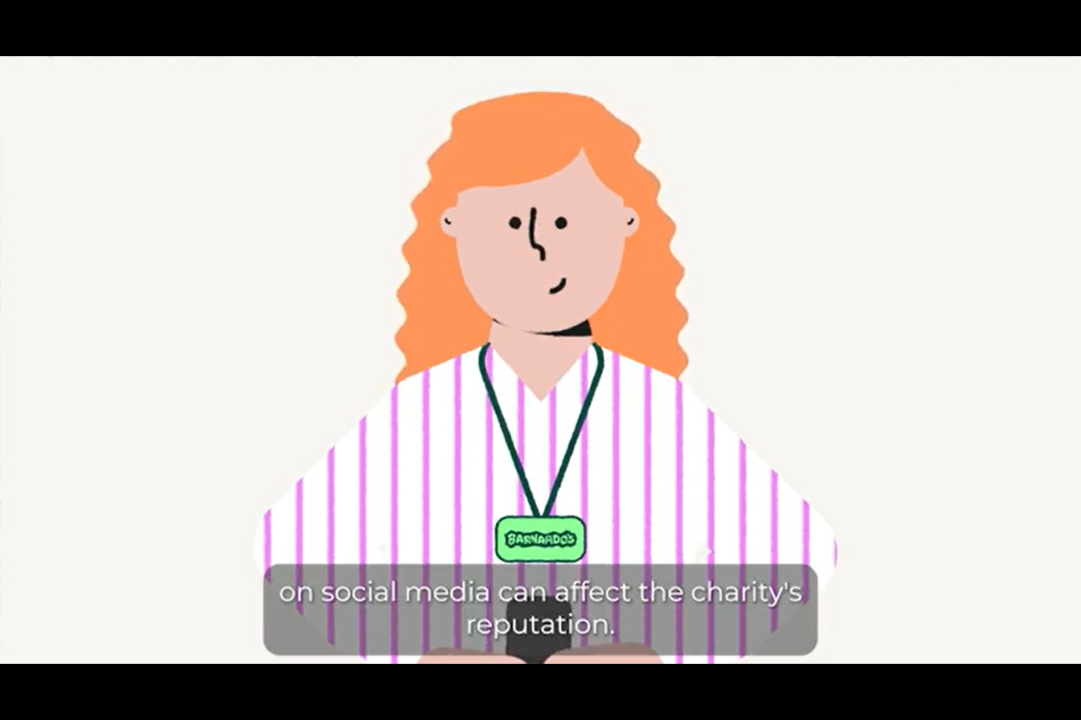
What this means for colleagues
As always, if you receive contact from a politician in relation to your work at Barnardo’s please contact the Policy & Public Affairs Team.
As always, if you receive contact from a journalist in relation to your work at Barnardo’s please contact the Media Team.
If you have any public speaking engagements, then please remember that what is said can be reported immediately on social media and also by journalists. Remember not to say anything, even in what feels like a friendly environment, that could harm Barnardo’s reputation, and please contact colleagues in the Policy & Public Affairs Team and the External Communications Team for support.
Please make sure you follow our Social Media Policy – both when using any Barnardo’s accounts and your own accounts. If you are publicly linked with Barnardo’s then what you say can affect the charity’s reputation. Watch the explainer video for advice.

Slide 8
Useful links
Advocacy & Campaigning Policy
Barnardo's Strategy
Theory of Change
Social Media Policy

Slide 9
Debbie Moss​
Director of Strategy & External Affairs

